Slide 1

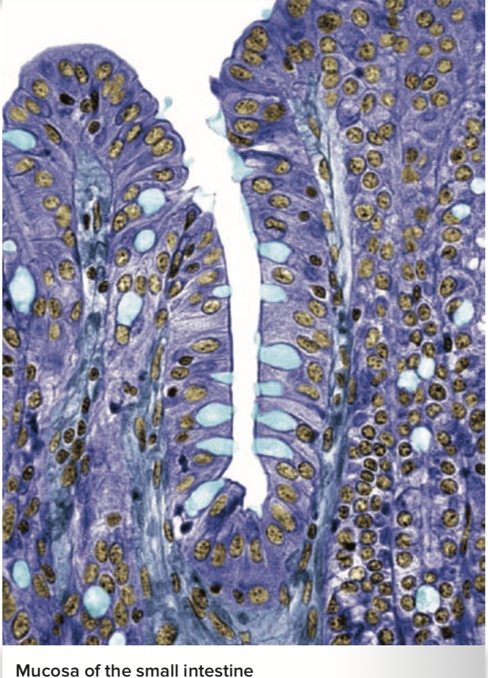
The Digestive System
Al-Farabi Kazakh National University
Higher School of Medicine
The Small Intestine and Large Intestine
Figure from: Saladin, Anatomy & Physiology, McGraw Hill, 2018

Slide 2
LEARNING OUTCOMES
As a result of the lesson you will be able to:
describe the gross and microscopic anatomy of the small intestine;
state how the mucosa of the small intestine differs from that of the stomach, and explain the functional significance of the differences;
define contact digestion and describe where it occurs; and
describe the types of movement that occur in the small intestine.
describe how each major class of nutrients is chemically digested,
name the enzymes involved, and discuss the functional differences among these enzymes;
describe how each type of nutrient is absorbed by the small intestine.
Al-Farabi Kazakh National University
Higher School of Medicine

Slide 3

Gross Anatomy
coiled mass filling most of the abdominal cavity inferior to the stomach and the liver
small intestine divided into three regions:
  duodenum
  jejunum
  ileum
ileocecal junction – the end of the small intestine
ileocecal valve – a sphincter formed by the thickened muscularis of the ileum
Describe the three regions of the small intestine and their respective lengths and histological differences ?

Slide 4
Circulation
superior mesenteric artery give rise to 12 to 15 jejunal and ileal arteries leading to the intestinal wall
Branches of these arteries give rise to capillary beds in the villi, where the blood picks up all absorbed nutrients except lipids.
Blood from here converges on another fan- like array of mesenteric veins, which leave by way of the superior mesenteric vein joins the splenic vein and then flows into the hepatic portal system, headed for the liver with its load of nutrients .

Slide 5
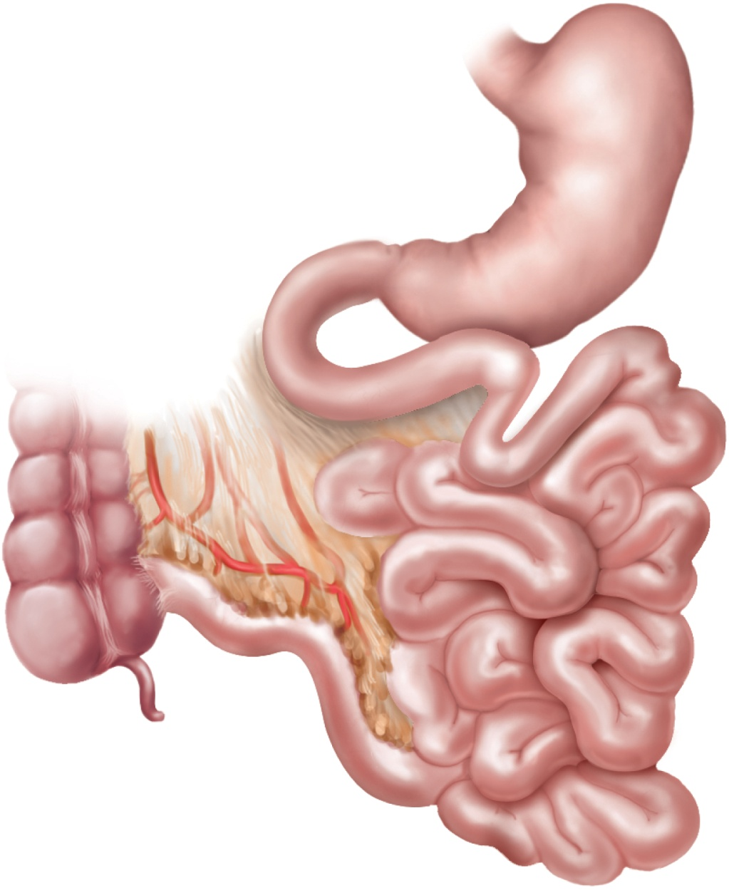
Small Intestine
Copyright © The McGraw-Hill Companies, Inc. Permission required for reproduction or display.
Figure from: Saladin, Anatomy & Physiology, McGraw Hill, 2018
Stomach
Duodenum
Duodenojejunal
flexure
Jejunum
Ascending
colon
Mesentery
Ileocecal
junction
Cecum
Appendix
Ileum

Slide 6
Microscopic Anatomy
tissue layers have modifications for nutrient digestion and absorption
  lumen
  muscularis externa
  large internal surface area
    great length and three types of internal folds or projections
      circular folds (plicae circulares)
      villi
      - microvilliintestinal crypts (crypts of Lieberkühn)
- duodenal glands
- defensive lymphocytes

Slide 7
Intestinal Secretion
intestinal crypts secrete 1 to 2 L of intestinal juice per day
Describe the brush border enzymes of the small intestine and their functions?

Slide 8
Intestinal Motility
Describe the functions of small intestine
contractions ?
segmentation – the movement in which stationary ringlike constrictions appear in several places along the intestine
— pacemaker cells
Peristalsis - gradual movement of contents towards colon.
- peristaltic wave
- migrating motor complex
- ileocecal valve
- gastroileal reflex

Slide 9
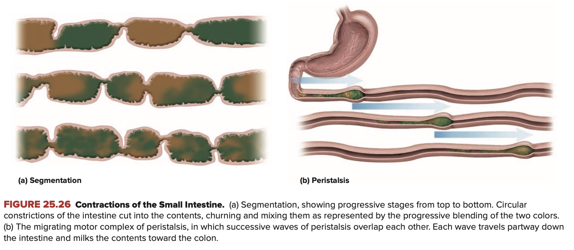
Copyright © The McGraw-Hill Companies, Inc. Permission required for reproduction or display.
Figure from: Saladin, Anatomy & Physiology, McGraw Hill, 2018

Slide 10
Chemical Digestion and Absorption
Carbohydrate Digestion
starch – the most digestible carbohydrate
    oligosaccharides
    disaccharide maltose
    glucose
Describe the Steps in carbohydrate digestion from the mouth to small intestine ?

Slide 11
Carbohydrate Absorption
Plasma membrane of the absorptive cells has transport proteins that absorb monosaccharides as soon as the brush border enzymes release them
Describe the Mechanisms of monosaccharide absorption by the intestinal mucosa ?

Slide 12
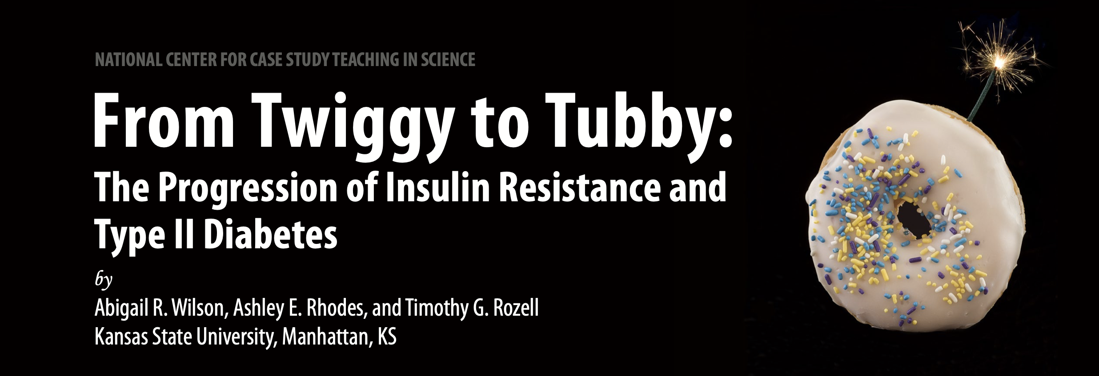

Slide 13
Glucose Digestion and Absorbtion
Timmy had been way too skinny for as long as he could remember; he’d had a growth spurt early in high school but in spite of stopping at 6 ́2 ̋ he was teased unmercifully by his friends and family for being a twig, only weighing 160 lb. Although he didn’t realize it at the time, his lean physique contributed to his achievement
of the highest vertical leap of all the athletes in his high school district and he was extremely well coordinated. Timmy made the varsity basketball team as a freshman in high school and was a starter all four years, making frst-team all-conference his junior and senior year. In spite of his athletic success, mostly he just heard the name calling and jokes about being so thin, and he packed in as many calories as he possibly could. In fact, all through high school Timmy chose his foods based on the amount of carbohydrates they contained. He had at least four large energy drinks per day, ate a large pizza and a box of donuts for lunch, snacked on one or two family size bags of potato chips, and his nightly routine consisted of chocolate milk and Oreo cookies. While he was the all-star basketball player in high school, his height left him with just a few scholarship ofers from smaller schools and junior colleges. However, Timmy’s ultimate dream was to become a surgeon so he chose to turn down all the scholarship ofers and attend a large university with an excellent pre-med program.

Slide 14
Glucose Digestion and Absorbtion
this point in Timmy’s life, he is able to metabolize glucose efciently. Due to the fact that Timmy is extremely active, the cells in his body use glucose to make energy at a relatively fast rate to keep up with his active lifestyle. Let’s take a closer look at what happens to the glucose Timmy consumes while he’s still young, active, and healthy.
While carbohydrates are important for energy production in the body, many of us consume far too many carbohy- drates just like Timmy. Tere are two basic types of carbohydrates: simple carbohydrates, or monosaccharides and disaccharides, and complex carbohydrates, or polysaccharides.
Te process by which carbohydrates are made available to cells in the body begins with the movement of food from the mouth through the esophagus, into the stomach, and lastly into the small intestine where the fnal steps for chemical digestion and absorption occur. Digestion is the chemical or mechanical breakdown of nutrients whereas absorption
is movement of nutrients in their simplest form into the body, this primarily occurs in the small intestine but some absorption can also occur through oral mucosa

Slide 15
Glucose Digestion and Absorbtion
Mechanical breakdown is the physical breakdown of food, which involves grinding food with teeth or the muscular layers of the stomach. Chemical breakdown requires enzymes to break bonds, such as the breakdown of polysaccharides into monosaccharides and disaccharides. While most carbohydrates are chemically digested in the small intestine via enzymes secreted by the pancreas and intestinal mucosa, small amounts of chemical digestion also occur within the oral mucosa via salivary amylase. Efective carbohydrate digestion allows simple carbohydrates, such as the monosac- charide glucose, to be absorbed into intestinal epithelial cells called enterocytes.
Glucose is found in many, many foods, even those that do not taste sweet. Glucose is a large, polar, water-soluble molecule and therefore cannot passively difuse across a cell membrane without transport membrane proteins. Once monosaccharides, like glucose, have passed through enterocytes, they will difuse into the extracellular fuid (ECF) and fnally into the blood via facilitated difusion. Lastly, they will travel through the blood to the cells throughout the body, such as skeletal muscle cells to produce energy or energy stores, called ATP and glycogen respectively.

Slide 16
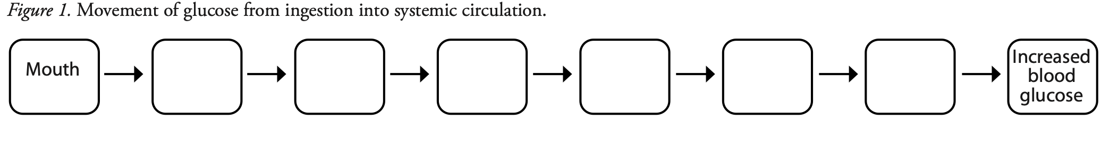
Fill in the fowchart indicating where a polysaccharide travels through the GI tract beginning with oral ingestion and ending with monosaccharide and disaccharide absorption into the blood?

Slide 17
Compare and contrast the processes of mechanical and chemical digestion in relation to the breakdown of polysaccharides. Where in the GI tract do each of these processes occur and what is involved in these processes?

Slide 18
How would a diet that includes more simple carbohydrates, rather than complex carbohydrates, impact glucose absorption from the GI and into enterocytes?

Slide 19
What might happen to glucose levels in the blood if carbohydrates could not be efciently digested within the GI tract?

Slide 20
Glucose Digestion and Absorbtion
After Timmy would play a hard game of basketball, he liked to cool down with a large chocolate milkshake. Every time he gulped down his post-workout milkshake he noticed that he soon felt ready for more basketball action, almost as though he had a renewed level of energy. His muscles felt good and he was ready for more. Considering Timmy’s burst of energy after his ice cream ritual, we can conclude that he was able to ingest, absorb, and uptake glucose efciently and utilize this glucose for energy within his skeletal muscle cells that provided him with the ability to run, dribble, and shoot basketball.

Slide 21
Glucose Digestion and Absorbtion
Once carbohydrates are broken down into their monomers, the process of absorption can begin. Te sodium glucose- linked transporter (SGLT-1) is the primary transporter used for glucose absorption from the lumen of the small intes- tine into the intestinal epithelial cells called enterocytes. As indicated by its name, the SGLT-1 moves both sodium and glucose at the same time, making it a symporter. Like most symporters, the SGLT-1 relies on the work of Na+/K+ pumps to keep intracellular sodium levels low. Tese pumps are located along the basolateral membrane of enterocytes and use ATP to continuously pump sodium out of the cell while pumping K+ into the cell. Once glucose enters the enterocyte via the SGLT-1 it will difuse into the extracellular fuid (ECF) through a uniporter transport protein called GLUT2 located on the basolateral membrane. GLUT2 also permits facilitated difusion, as glucose moves from a high concentration to a low concentration.
When luminal glucose levels are very high, for example, after fnishing a meal, GLUT2 can also assist the SGLT-1 transporters on the apical side of the enterocytes. Te translocation, or movement between cellular compartments, of some GLUT2 transporters from the basolateral membrane to the apical membrane of the enterocyte helps increase glucose absorption. When glucose levels within the enterocyte are low, glucose will still difuse into the cell because the Na+/K+ ATPase pumps continually pump sodium out of the enterocyte to drive sodium into the cell, and thus pull glucose and sodium through the SGLT-1

Slide 22
Glucose Digestion and Absorbtion
Recall that after Timmy absorbs the glucose from his chocolate milkshake, he gets a burst of energy and is ready to play another round of basketball. As long as Timmy is able to absorb glucose from his diet efciently it will enter his blood stream and will travel to his body’s cells, including pancreatic beta cells. When pancreatic beta cells receive glucose from the blood they respond by releasing insulin. Tis hormone travels in the blood and signals any cell possessing an insulin receptor to take up glucose from the blood. Insulin is required for glucose uptake in some cells; these are referred to as insulin dependent cells and include resting skeletal muscle cells and adipocytes, or fat cells. Insulin independent tissues can absorb glucose without insulin; these include exercising skeletal muscle cells, neurons and glial cells, and hepato- cytes, or liver cells. We will use a skeletal muscle cell as our model for understanding how this process occurs.
In skeletal muscle cells, insulin receptors are located on the sarcolemma and t-tubules. Once insulin binds to its receptor, a second messenger pathway is activated which involves intracellular signaling that results in the translocation of GLUT4 to the sarcolemma or t-tubules. GLUT4 is a transport protein that is stored and moves within the cell via storage vesicles. Te storage vesicle will fuse to the sarcolemma or t-tubule to provide GLUT4 transporters and will allow a way for glucose to enter the skeletal muscle cell. Te expression of GLUT4 within the sarcolemma or t-tubule is triggered by both insulin and muscle contraction. Tus, skeletal muscle cells can be considered as both insulin de- pendent and insulin independent. Regardless of what activates GLUT4 translocation to the sarcolemma and t-tubules, glucose will enter the skeletal muscle cell and be used for ATP or glycogen production.

Slide 23
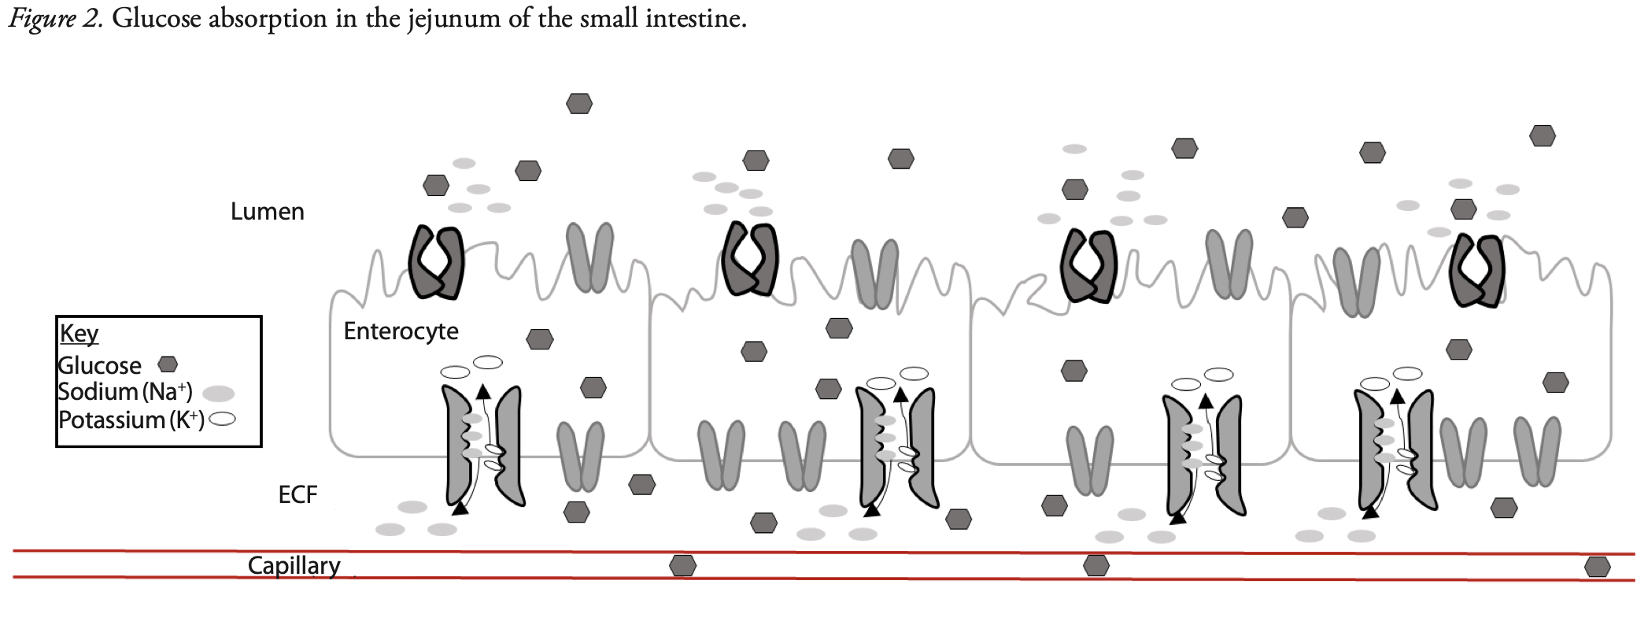
In the figure below, use arrows to label the Na+/K+ pumps, SGLT-1 transporters, and GLUT2 transporters. Ten, indi- cate the direction in which glucose and sodium are moving through the SGLT-1 and GLUT2 transporters using arrows.

Slide 24
Proteins
amino acids absorbed by the small intestine come from three sources:
  dietary proteins
  digestive enzymes digested by each other
  sloughed epithelial cells digested by enzymes
endogenous amino acids
exogenous amino acids
proteases (peptidases) - enzymes that digest proteins
  begin their work in the stomach in optimum pH of 1.5 to 3.5
  pepsin hydrolyzes any peptide bond between tyrosine and phenylalanine
Describe the Steps in protein digestion from the mouth to small intestine ?

Slide 25
Protein Absorption
At the basal surfaces of the cells, amino acids behave like the monosaccharides, they leave the cell by facilitated diffusion, enter the capillaries of the villus, and are carried away in the hepatic portal circulation.
The absorptive cells of infants can take up intact proteins by pinocytosis and release them to the blood by exocytosis.
Describe the Mechanisms of amino acid absorption by the intestinal mucosa ?

Slide 26
Lipids
hydrophobic quality of lipids makes their digestion and absorption more complicated that carbohydrates and proteins
lipases – fat digesting enzymes
  lingual lipase secreted by the intrinsic salivary glands of the tongue
  pancreatic lipase – in the small intestine digest most of the fats
  bile
    lecithin and bile acids
Describe the Steps in fat digestion from the mouth to small intestine ?

Slide 27
emulsification droplets
The stomach’s vigorous antral pumping breaks the fat up into small droplets dispersed through the watery chyme, exposing much more of its surface to enzymatic action.
Describe the role of bile acids and lecithin in this process ?

Slide 28
Lipid Absorption
micelles
  made in the liver
  consist of 20 to 40 bile acid molecules aggregated with their hydrophilic side groups facing outward and their hydrophobic steroid rings facing inward
  bile phospholipids and cholesterol diffuse into the center of the micelle to form its core
  micelles pass down the bile duct into the duodenum
    where they absorb fat soluble vitamins, more cholesterol, and the FFAs and monoglycerides produced by fat digestion
  they transport lipids to the surface of the intestinal absorptive cells
  lipids leave the micelles and diffuse through the plasma membrane into the cells
  micelles are reused, picking up another cargo of lipid,
  transporting them to the absorptive cells

Slide 29
Lipid Absorption
Chylomicrons
droplets 75 to 1,200 nm in diameter which is from Golgi complex combines triglycerides with a small amount of cholesterol and coats the complex with a film of phospholipid and protein
released into the lymphatic system in the lacteals of the villi. They enter the bloodstream when lymphatic fluid enters the subclavian vein via the thoracic duct.
Describe the differences between emulsification droplets, micelles, and chylomicrons in lipid processing ?

Slide 30
Nucleic Acids and Vitamins
nucleic acid
  nucleases (deoxyribonuclease and ribonuclease) hydrolyze DNA and RNA to nucleotides
  nucleosidases and phosphatases of brush border split them into phosphate ions, ribose or deoxyribose sugar, and nitrogenous bases
vitamins
  are absorbed unchanged
  fat-soluble vitamins - A, D, E and K absorbed with other lipids
    if they are ingested without fat-containing food, they are not absorbed at all, but are passed in the feces and wasted
  water-soluble vitamins, B complex and C, absorbed by simple diffusion and B₁₂ if bound to intrinsic factor from the stomach

Slide 31
Minerals
minerals (electrolytes)
  are absorbed all along small intestine
  Na⁺ cotransported with sugars and amino acids
  Cl⁻ exchanged for bicarbonate reversing chloride-bicarbonate exchange that occurs in the stomach
  iron and calcium absorbed as needed
    iron absorption is stimulated by liver hormone hepcidin
    absorptive cells bind ferrous ions (Fe²⁺) and internalize by active transport
    unable to absorb ferric ions (Fe³⁺) but stomach acid reduces ferric ions to absorbable ferrous ions
    transferrin (extracellular protein) transports iron in blood to bone marrow, muscle, and liver

Slide 32
Calcium
calcium is absorbed throughout the intestine by different mechanisms
  active transport in the duodenum
    enters through calcium channels in apical cell membrane
    binds to calbindin protein so concentration gradient will continue to favor calcium influx
    actively transported out of base of cell into bloodstream by calcium-ATPase and Na⁺-Ca²⁺ antiport
  diffusion between epithelial cells in jejunum and ileum
parathyroid hormone – secreted in response to a drop in blood calcium levels
  stimulates kidney to synthesize vitamin D from precursors made by epidermis and liver
  vitamin D affects the absorptive cells of the duodenum in three ways:
    increases number of calcium channels in apical membrane
    increases the amount of calbindin in the cytoplasm
    increase the number of calcium-ATPase pumps at basal membrane
  parathyroid hormone increases the level of calcium in the blood

Slide 33
Water Balance
water is absorbed by osmosis following the absorption of salts and organic nutrients
diarrhea - occurs when large intestine absorbs too little water
  feces pass through too quickly if intestine is irritated
  feces contains high concentrations of a solute (lactose)
constipation – occurs when fecal movement is slow, too much water gets reabsorbed, and feces becomes hardened

Slide 34
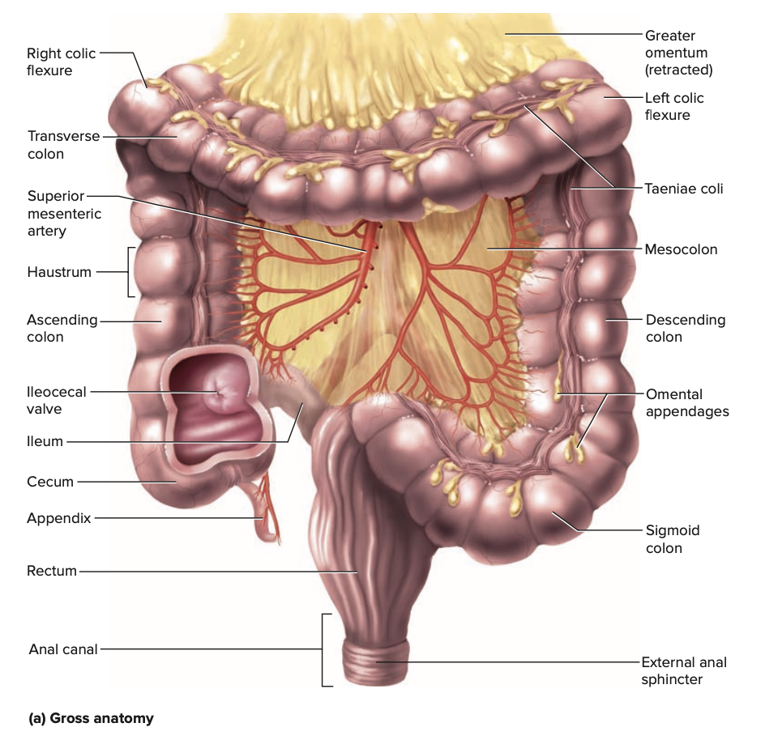
Anatomy of Large Intestine
Copyright © The McGraw-Hill Companies, Inc. Permission required for reproduction or display.
Figure from: Saladin, Anatomy & Physiology, McGraw Hill, 2018

Slide 35
Gross Anatomy of Large Intestine
large intestine
  measures 1.5 m (5 ft) long and 6.5 cm (2.5 in) in diameter in cadaver
  cecum inferior to ileocecal valve
  appendix attached to the lower end of the cecum
  ascending colon, right colic (hepatic) flexure, transverse colon, left colic (splenic) flexure, and descending colon frame the small intestine
  sigmoid colon is S-shaped portion leading down into pelvis
  rectum - portion ending at anal canal
  anal canal – final 3 cm of the large intestine

Slide 36
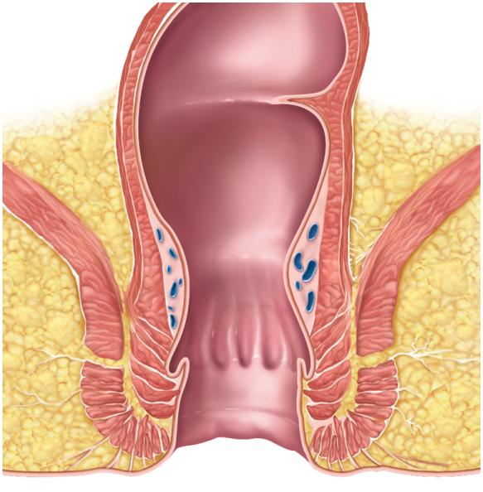
Anatomy of Anal Canal
Copyright © The McGraw-Hill Companies, Inc. Permission required for reproduction or display.
Figure from: Saladin, Anatomy & Physiology, McGraw Hill, 2018
Figure 25.31b
Rectum
Rectal valve
Anal canal
Levator ani
muscle
Hemorrhoidal
veins
Internal anal
sphincter
External anal
sphincter
Anus
Anal columns
Anal sinuses
(b) Anal canal

Slide 37
Absorption and Motility
large intestine takes about 12 to 24 hours to reduce the residue of a meal to feces
  does not chemically change the residue
  reabsorbs water and electrolytes
haustral contractions occur every 30 minutes
  this kind of colonic motility is a form of segmentation
  distension of a haustrum stimulates it to contract
mass movements occur 1 to 3 times a day
  triggered by gastrocolic and duodenocolic reflexes
    filling of the stomach and duodenum stimulates motility of the colon
    moves residue for several centimeters with each contraction

Slide 38
Defecation
stretching of the rectum stimulates defecation reflexes
  intrinsic defecation reflex works entirely within the myenteric plexus
  parasympathetic defecation reflex involves spinal cord
    stretching of rectum sends sensory signals to spinal cord
    pelvic nerves return signals intensifying peristalsis and relaxes the internal anal sphincter
    defecation occurs only if external anal sphincter is voluntarily relaxed
abdominal contractions (Valsalva maneuver)

Slide 39
Reference:
Saladin, Anatomy & Physiology, McGraw Hill, New York,2018
National center for case study teaching in science. https://sciencecases.lib.buffalo.edu/

